Slide 1

Flight Delays by Days: Applied Data Analytics to Identify Factors Associated with Flight Delays
BIT 5534 Group 6

Slide 2





Agenda
Business Problem
Description of Data
Variable Dictionary
Analyses
ANOVA
Linear Regression
PCA
Neural Network
Conclusions

Slide 3

Business Problem
The aviation industry plays a significant role in transportation
Flight delays heavily impact the efficiency and operations of the aviation industry
  Potential causes:
    Weather
    Security issues
    Inefficient operations
We propose to better understand flight delays so we can predict when they are most likely to occur

Slide 4

Description of Data
The dataset includes 562,785 cases with more than 50 attributes
We focused on the following variables:
  origin airport
  destination airport
  difference in minutes between actual departure and scheduled departure (“departure delay”)
  distance flown
  day of month (as a number)
  day of week (as a number)

Slide 5
Variable Dictionary
Variable Name | Variable Type | Description
Orig (Origin airport) | Categorical | Origin airport
OriginState | Categorical | The name of the state where the flight originated
Dest (Destination airport) | Categorical | Destination airport
DestState | Categorical | The name of the state of the flight’s destination
DepDelay | Continuous | Difference in minutes between scheduled and actual departure time (early departures show negative numbers)
DepDelayGroups | Continuous | Departure delay intervals, (every 15 minutes from < -15 to > 180)
ArrDelay | Continuous | Difference in minutes between scheduled and actual arrival time (early arrivals show negative numbers)
ArrDelayGroups | Continuous | Arrival delay intervals, (every 15 minutes from < -15 to > 180)
CancellationCode | Categorical | Reason for the cancellation
Distance | Continuous | Distance between airports, in miles
Quarter | Categorical | Quarter of the year (first, second, third, or fourth)
Month | Categorical | Month in which the flight occurred, from 1 - 12
Day of Month | Categorical | The day of month, from 1 - 31
Day of Week | Categorical | The day of week, from 1 - 7
Operating Airline | Categorical | Name of the airline operating the flight

Slide 6

Analyses
ANOVA
Linear Regression
PCA
Neural Network

Slide 7
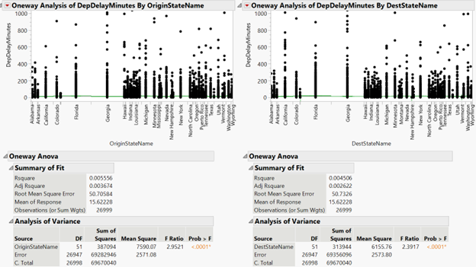
Analysis of Variance
(ANOVA)
Both input variables are slightly able to explain the variation in departure delay, although there is not a strong association (origin state: F-ratio = 2.95, p < 0.05; destination state: F-ratio = 2.39, p < 0.05).
The F-ratios are significant, so we can reject the null hypothesis.
However, the adjusted R² values < 0.01 so it is not a lot of explanatory power in our outcome variable
Notes:
An ANOVA was estimated with the input variables, origin state and destination state, and the outcome variable, departure delay in minutes. Both input variables are slightly able to explain the variation in departure delay, although there is not a strong association (origin state: F-ratio = 2.95, p < 0.05; destination state: F-ratio = 2.39, p < 0.05). The F-ratios are significant, so we can reject the null hypothesis which says there is no difference between the origin states or the destination states and departure delay. However, the adjusted R² values < 0.01 so it is not a lot of explanatory power in our outcome variable

Slide 8
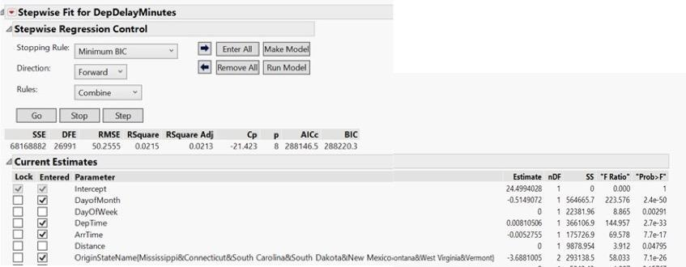
Linear Regression
A forward, stepwise regression was performed to find the best fitting model
Variables Included: day of month, departure time, arrival time, and origin state
The AIC is quite high despite being the lowest of various regression models (AIC = 288146.5)
The adjusted R-squared is less than 0.10 (adjusted R² = 0.02, p < 0.05)
Only 2% of the variance in departure delay is explained by the input variables

Slide 9
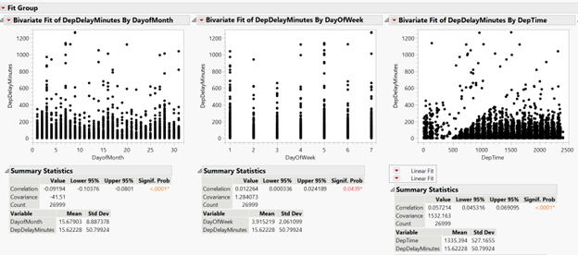
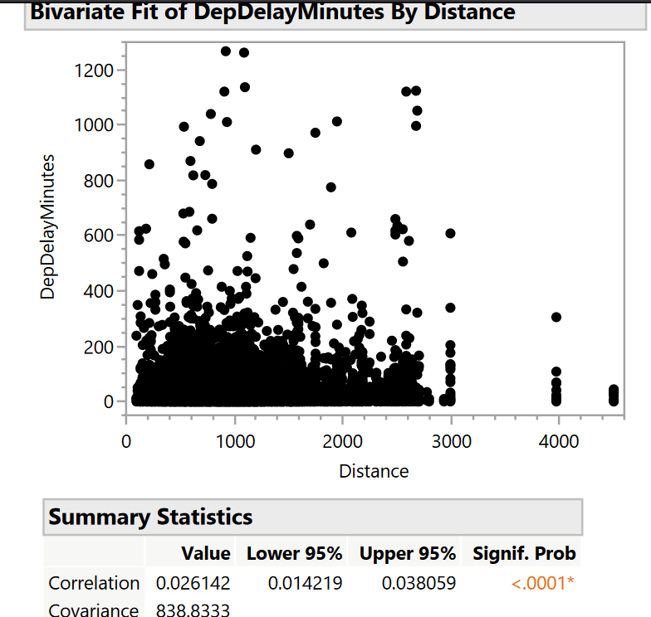
Linear Regression cont’d
Thus, to see each predictor variable’s effect on the outcome – departure delay in minutes – we fit a model for each variable
The p-values for all four variables are less than 0.05, which indicates a statistically significant model and that the test hypothesis can be rejected.

Slide 10
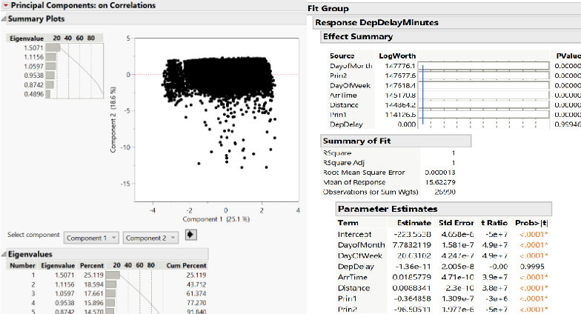
Principal Components Analysis (PCA)
The first component explains 25% of the outcome, dep. delay in minutes, while the second component explains 18 - 19%, and the third explains 17 - 18% of the outcome.
The multiple, stepwise regression that included principal components one and two was a great fit.
Adjusted R² = 1
  100% of the variance in departure delay minutes is explained by the included variables
RMSE = 0.000013
  Hardly any variance/residual observed between actual and expected values

Slide 11
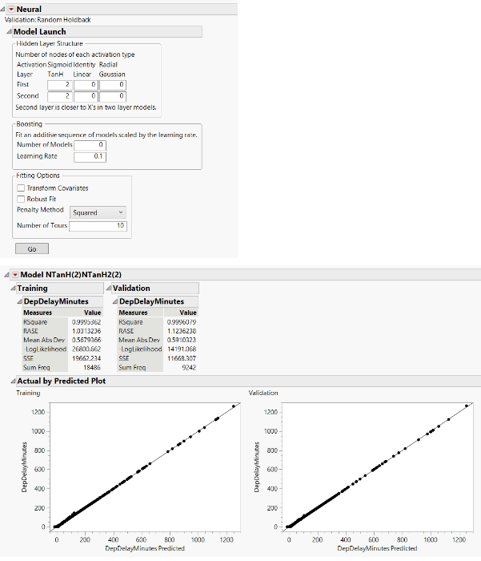
Neural Network
We modeled several Neural Networks, but the best fitting model had 2 layers and 2 nodes. Results were validated by running 10 tours.
R² was 0.999
RASE was 1.03 for training and 1.12 for validation.
99% of the variation in departure delay was associated with the input variables.
The models ability to predict against actual values was effectual

Slide 12

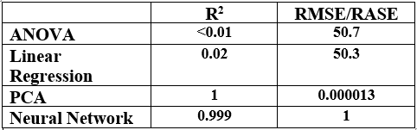
Conclusions
Among the different techniques we used, the non-parametric models performed better.
Principal Component Analysis was the model best fit for our data, demonstrated by 100% of input variable variance being accounted for and the least amount of squared errors.

